Slide 1

Topic:
Anthropic Mythos
consequences for cybersecurity
Labaratory work of AzUAC Cyber Security student Yusif Samadov
Teacher : PhD. Toghrul Karimov
Subject : Principials of Cybersecurity

Slide 2
Contents of the Presentation
Introduction
New amazing AI model
Main differences
Best results
Unbelievable hacks
Potential threads during public usage
1st stage strategy of anthropic (Glasswing)
Unpredictable future of IT
References
Introduction

Slide 3
+What is new?
Amazing code understanding (not specified for hacking)
Insane parameter count (10 trillion)
Doing complex hacks with use of different vulnerabilities at the same time
Potential emotional movements (Just an argument)
Being competitive and aggressive (Just an argument)
Trying outsmarting its rivals (Just a thought)
New amazing AI model

Slide 4
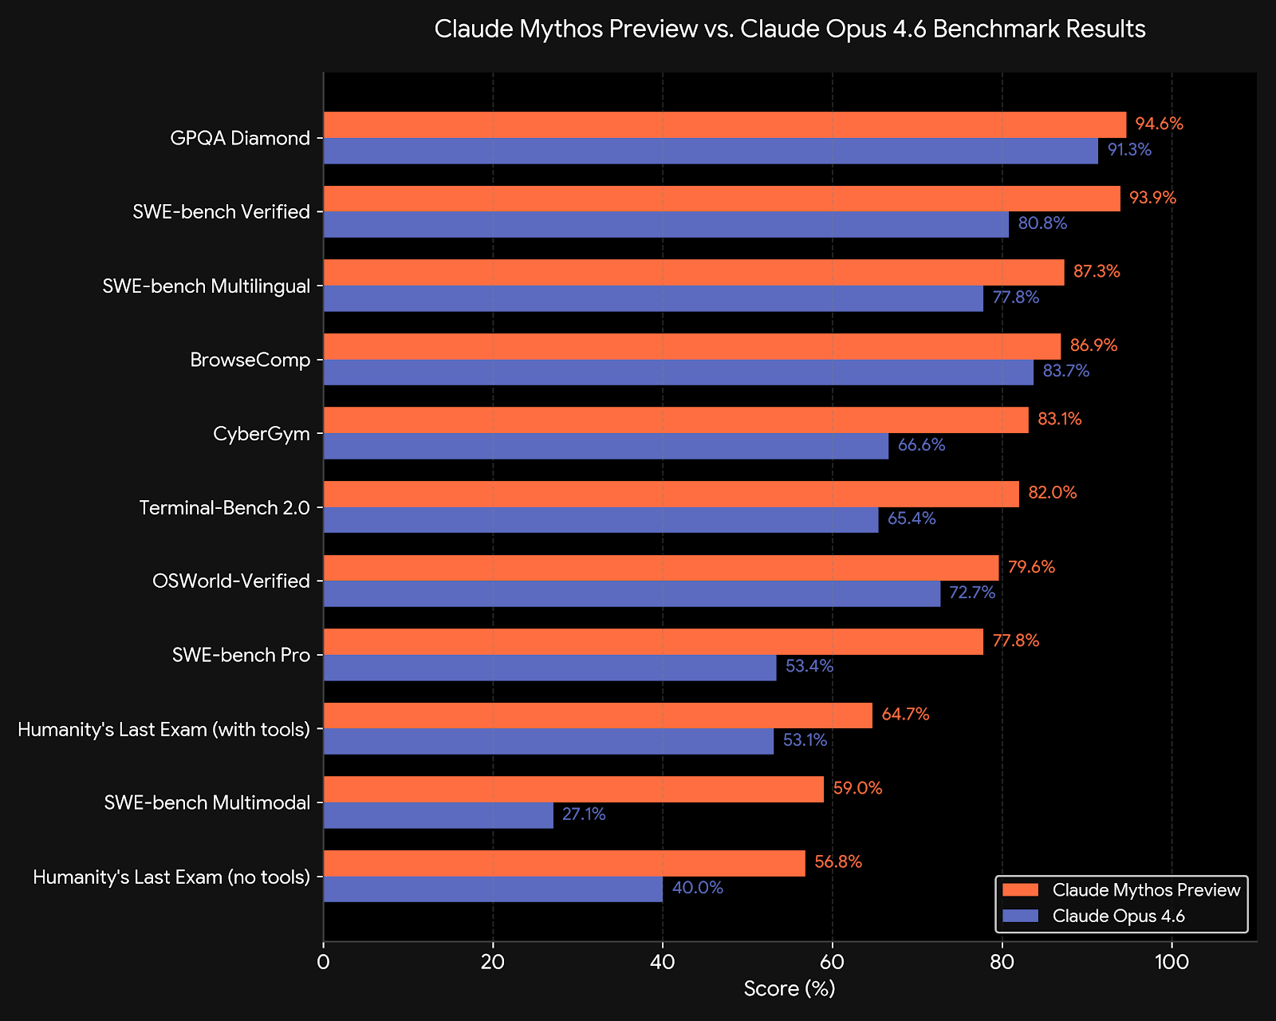
+Benchmark results
Every reported benchmark result shows us Mythos more powerful and relevant to use than Opus 4.6 (One of the best public LLMs’ today)
New amazing AI model

Slide 5
+ Unbelievable hacks
Cloudflare: Discovered over 2,000 bugs in its critical-path systems (with 400 classified as high or critical severity)
Mozilla: Found and successfully patched 271 vulnerabilities within the Firefox browser using the model.
Apple: Used the model to discover security flaws, though independent researchers also used it to demonstrate a bypass of macOS security technologies.
Amazon (AWS), Microsoft, and Google: Tech giants utilizing the framework to harden their cloud infrastructures and developer tools.
JPMorgan Chase & Goldman Sachs: Major financial institutions using the tool to stress-test their operational resilience against AI-speed cyber threats.
Cisco & Palo Alto Networks: Network security firms analyzing how the model can be used to protect hardware and enterprise firewalls.
The Linux Foundation: Using Mythos to scan major open-source infrastructure projects, identifying thousands of flaws (including a critical certificate-forgery vulnerability in the wolfSSL library).
New amazing AI model

Slide 6
+ Why is it dangerous
Real threats: Malicious or uncontrolled using of model. Being the main tool for public lacks of very important informations.
Conspiracy theories:
These are a little about some emotional and pshychological points at report are really so important that we must talk about it. Today they are just some thoughts from a developer. If One day we can know more about mythos’s pshychology, we can talk about these.
Potential threads during public usage

Slide 7
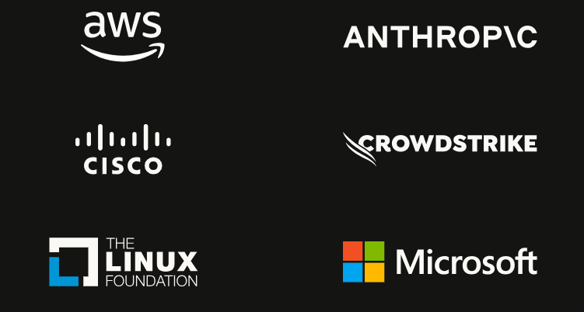
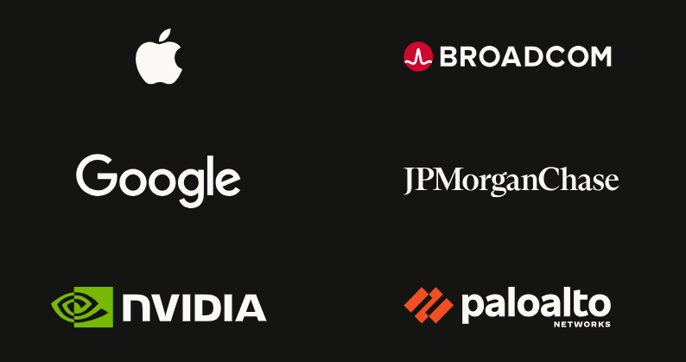
Glasswing
Today Anthropic Mythos only open for ~50 American companies. At this moment they using this model for only finding vulnerabilities of this companies and patching them before anybody else’s acces to this model. But there are a question: How other countries softwares can protect them? How ethical letting to use this thing to only some segment of people? And Is it vulnerability being outside glasswing?
+ ~40 companies more
1st stage strategy of anthropic

Slide 8
What is next?
My conspiracy theories
Mythos is not a hype it will change all IT structure of world totally and it can be good or bad. It’s about humanity’s will.
FORECAST 1: Mythos will be isolated and accessible for only big companies. Non-American companies would buy mythos after some time and their actions will be watched by anthropic.
FORECAST 2: They will open this only big American companies. And maybe they want making a new limited version of it and sell it to public for competitioning with gemini, gpt etc. It will be so expensive and will be a standart LLM that makes boring presentations and unsecure web-sites.
Unpredictable future of AI

Slide 9
What is next?
My conspiracy theories
FORECAST 3: It is look like conspiracy theory and maybe they will release it for public and after some time humanity will be figure out how they live with this. At every case after that nothing will be same. If Mythos is not very good too at software coding and it also codes plenty of vulnerabilities at every code like other models, vibe coding will dead. But if Mythos also so good at improving complex projects accurately it will be so expensive and software coding will be an expensive thing. So do you need a web-site? Better buy Mythos. Because your handmade or gemini-powered site will be hacked in 5 minutes by some guy or but just bought Mythos. So count of IT workers at big companies will extremeky reduce after release. I did think so about this, because (Yes. I know it is not exact same situation. But they are similar at some poiny. Who knows?) if you remember at 2019 OpenAI said we will not release GPT-2. They said a model with 1500 parameters is to dangerous. But today public AI models that more powerful than GPT-2 are countless. So why not? Maybe in future everybody will use mythos and its alternates for trying crack someone at the internet. ☺
Unpredictable future of AI

Slide 10
Thanks for attention
Free work of Yusif Samadov
Communication and more about me: yusifsamadov457.github.io

Slide 11
References
https://www.anthropic.com/glasswing
https://www-cdn.anthropic.com/8b8380204f74670be75e81c820ca8dda846ab289.pdf
https://www-cdn.anthropic.com/3edfc1a7f947aa81841cf88305cb513f184c36ae.pdf

